Slide 1
Tradition and Change in East Asia
Chapter 26

Slide 2
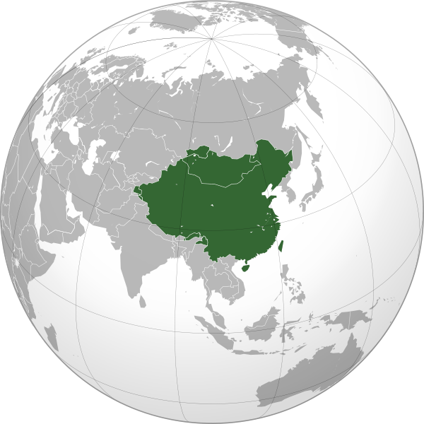
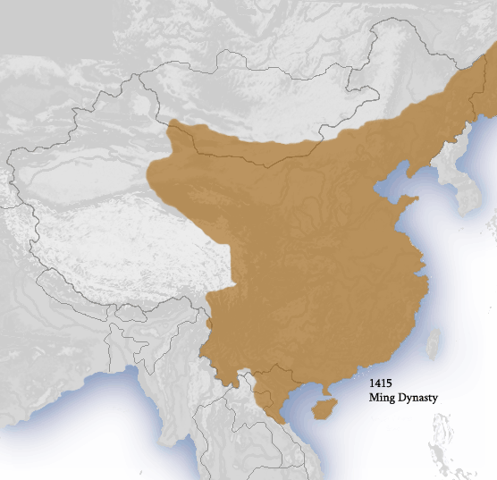
Intro: The quest for Political Stability
Recovery from Mongol rule: Ming
Qing: foreigners, but promoters of Chinese tradition
Goal for both: stability

Slide 3
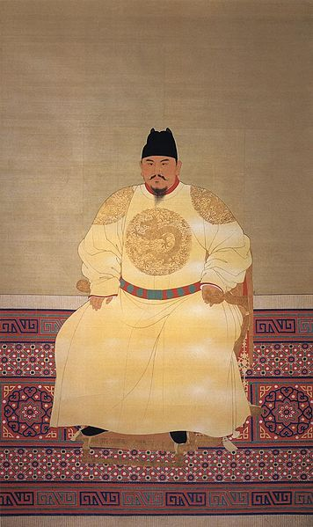
The Ming Dynasty (1368-1644)
founded by Hongwu (r. 1368-1398)
Drove the Mongols out
Reestablished centralized Chinese government
Used mandarins and eunuchs
Yongle (r. 1403-1424)
Naval expeditions in Indian Ocean
(Zheng He)
Capital to Beijing to monitor nomads

Slide 4
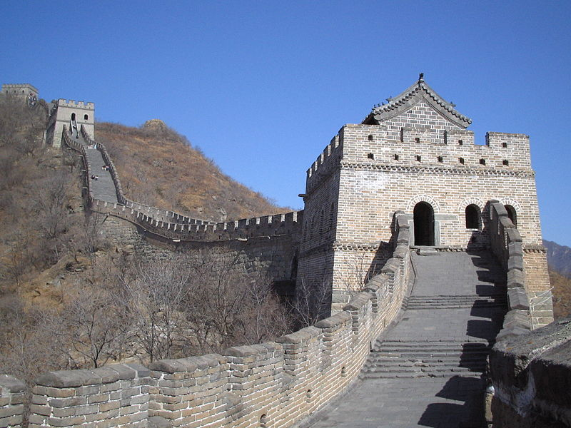
The Ming Dynasty (cont.)
Later, built upon and expanded Great Wall to end foreign threat (-> stable society)
Erased all evidence of the Mongols (esp. names)
Encouraged Chinese tradition: focus on Confucian studies, gov’t $ for schools, civil service exams

Slide 5
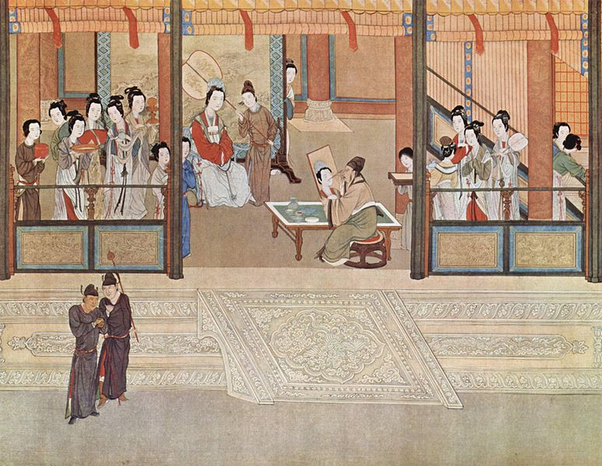
The Ming Dynasty (cont.)
Problems: 1500s – pirates and smugglers disrupted life along coast and emperors were disconnected from what was going on in society -> corruption and inefficiency
Early 1600s: famines (no gov’t relief)
1630s: peasant revolts and Manchu invasion
1644: rebels captured Beijing,
Manchus allied with army,
crushed rebels, took over

Slide 6
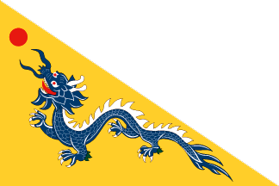
The Qing Dynasty (1644-1911)
Founded by Manchus from the north (pastoral nomads, trade rel. with China, occasional clashes)
Chieftain unified tribes -> centralized state, codified laws, powerful military
Early 1600s: expelled Chinese, captured Korea and Mongolia
1644: seized Beijing, continued
to fight Ming loyalists into the 1680s
Advantages: military power + Chinese support

Slide 7
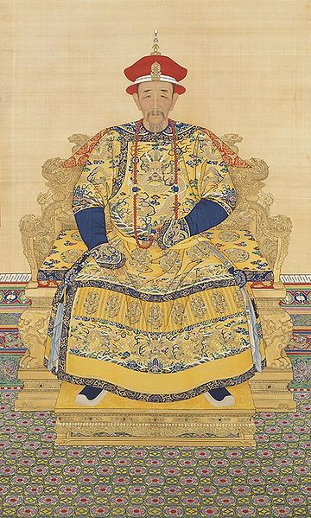
The Qing Dynasty (cont.)
Manchus: maintained ethnic identity (outlawed intermarriage, travel to Manchuria, learning Manchurian, and forced Manchu hairstyle on Chinese men to show submission)
Kangxi (r. 1661-1722): consolidated Manchu power
Pro-Confucianism: flood control, irrigation (rulers should look after subjects), schools
Military conquest: Taiwan, C. Asia,
later - vassal states (Vietnam, Burma,
Nepal)

Slide 8
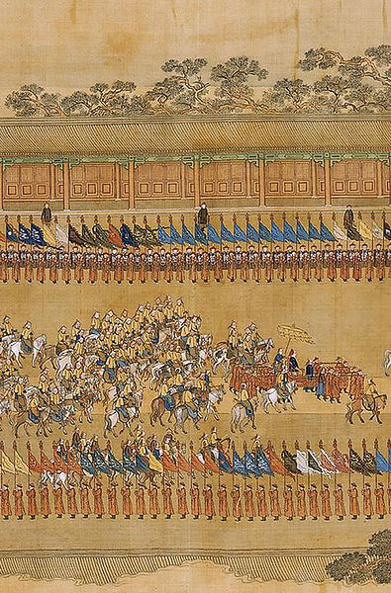
The Qing Dynasty (cont.)
Qianlong (r. 1735-1796): long, stable, prosperous
Patron of arts, Confucianism, full treasury (cancelled taxes)
But, towards the end, relied heavily on eunuchs
Successors did the same -> difficulties

Slide 9
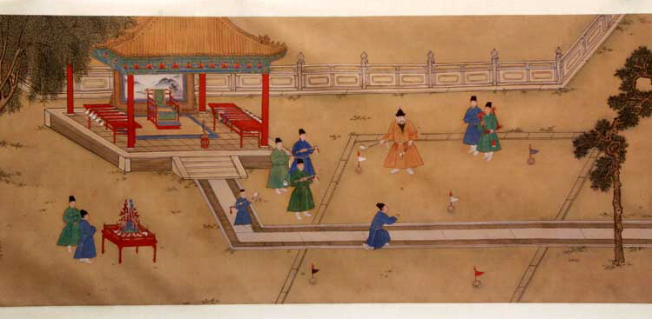
The Son of Heaven
Ming and Qing used traditional Chinese gov’t apparatus: highly centralized, scholar-bureaucrats
Emperor = son of heaven (privileged life in Forbidden City: concubines, eunuchs, court ritual, sumptuary laws, name taboo, kowtow, harsh punishments for minor offense)

Slide 10
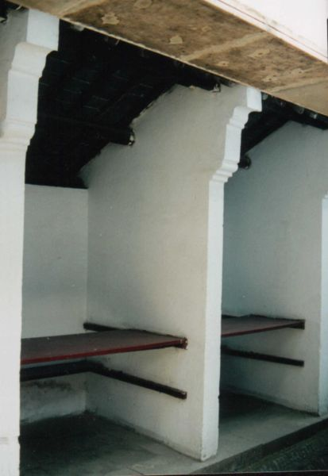
Scholar-Bureaucrats
Scholar-Bureaucrats: day-to-day governing activities; appointed by emperor from scholar-gentry class (well-educated
Exam prep: local schools, tutors, memorization of Confucian writing, plus calligraphy, poetry, essay writing, etc.
Exam: district, provincial,
metropolitan levels, quotas for
passing, grueling ordeal

Slide 11
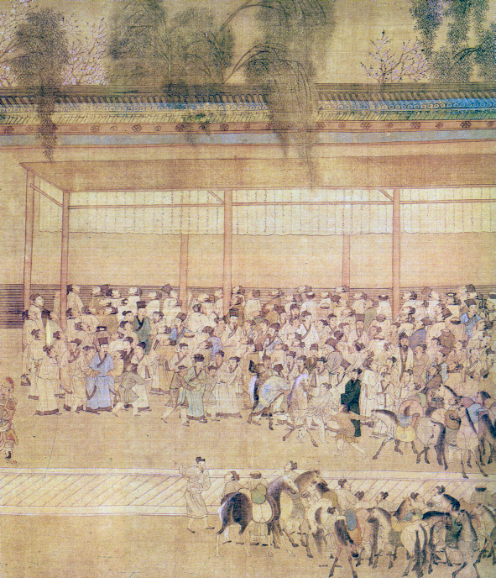
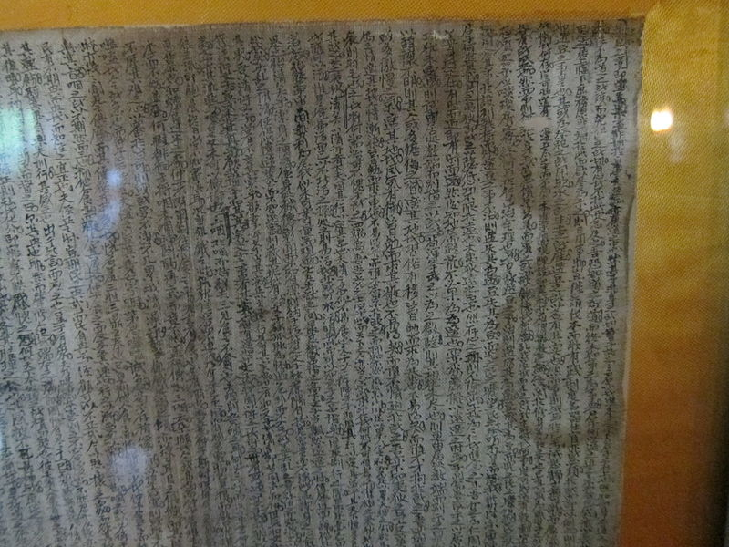
Scholar-Bureaucrats (cont.)
Highly competitive <- social and economic rewards (-> cheating, corruption)
Effect of system: encouraged education, allowed social mobility (but rich had advantages), and reinforced Confucian system

Slide 12
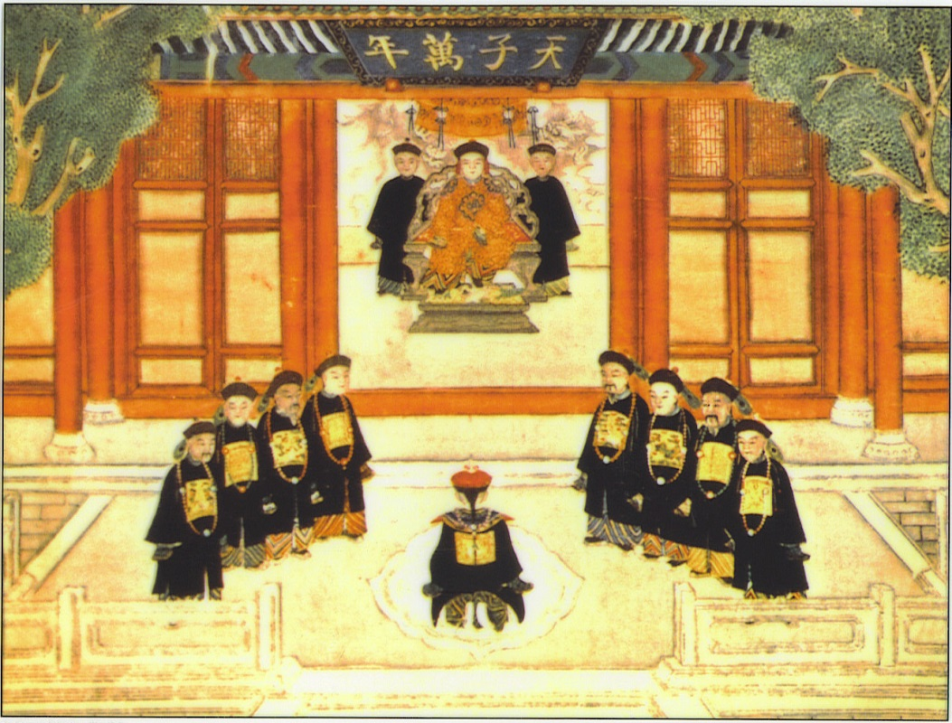
Intro: Economic and Social Changes
Restored and maintained Chinese traditions, including hierarchical and patriarchal social order
Economic and social changes still occurred due to foreign influence (new crops, global trade)

Slide 13
The Patriarchal Family
Filial piety: extended to emperor and his subjects (hierarchical, patriarchal, authoritarian)
Also extended to clans (patrilineal descent groups that cut across class lines): important politically and economically at local level
Gender relations: subordination of women
Girls: seen as social and financial liability (female infanticide was common), tighter control than before, foot-binding (esp. among wealthy)
Boys: potential source of honor to family
Marriage: bride moved in with and became subservient to husband’s family; women could not divorce (men could)

Slide 14
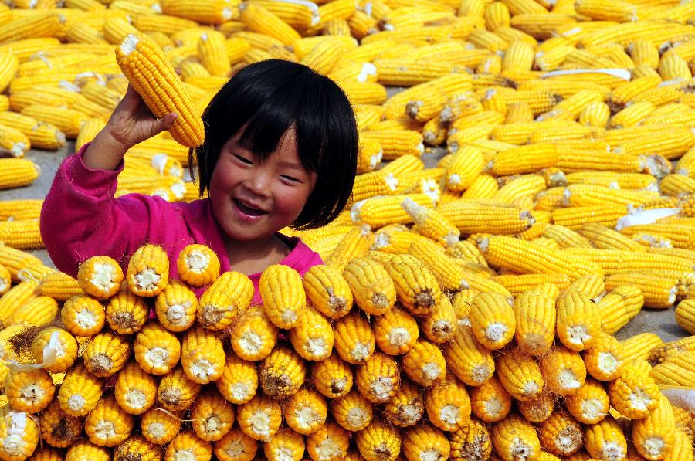
Population Growth
Intensive cultivation of all suitable land -> increasing crop yields, but maxed out in 17th century
Mid-1600s: Spanish (via the Philippines) introduce maize, sweet potatoes, peanuts -> could take advantage of unused land -> increase in food supply -> population growth
Commercial opportunities
increased as labor and silver
increased

Slide 15
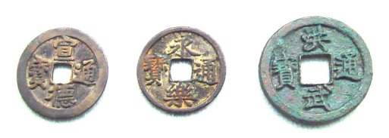
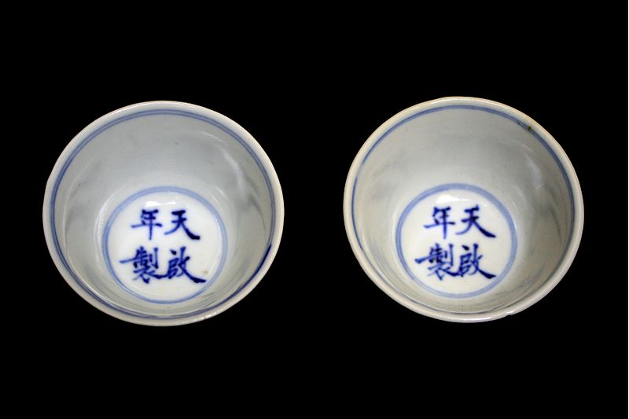
Economic Development
Foreign Trade: exports – silk, porcelain, lacquerware, tea
Imports – spices, exotics, wool, SILVER
Lots of government regulation: after Zheng He, increasing isolationism - Qing tried to stop all maritime trade (exception Portuguese at Macau and British at Guangzhou)
But, maritime trade still
happened (Manilla, Batavia)

Slide 16
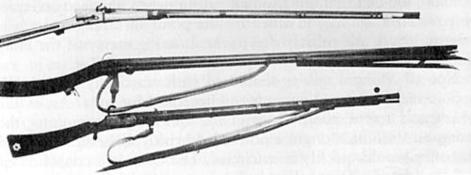
Government and Technology
Tang and Song – lots of inventions
Ming and Qing – little innovation or invention
Adopted European inventions (cannons, guns – the irony!!)
Why? Gov’t favored political and social stability over change, plus, abundance of labor did not make inventions necessary -> lagged behind Europe in technology

Slide 17
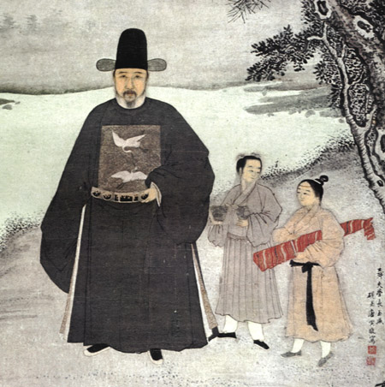
Social Organization
Privileged classes: emperor and family
Scholar-bureaucrats/gentry: important in local gov’t (esp. water control), distinctive clothing, honorifics, legal treatment, land owners (some also owned shops), lived in urban areas
Working Classes (commoners):
Peasants: honorable (food providers
and hard workers)
Artisans/workers: tailors, barbers, physicians
Merchants: wealth and influence, but lower status, worked with gentry, educated children

Slide 18
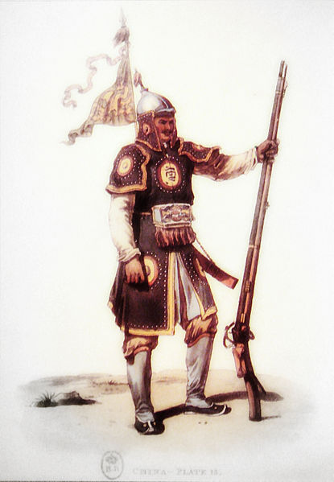
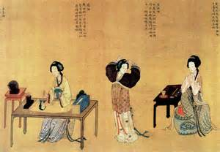
Social Organization (cont.)
Lower classes:
Armed forces (considered necessary evil); led by civilian bureaucrats
Mean people: slaves, indentured servants, entertainers, prostitutes, and other marginal groups

Slide 19
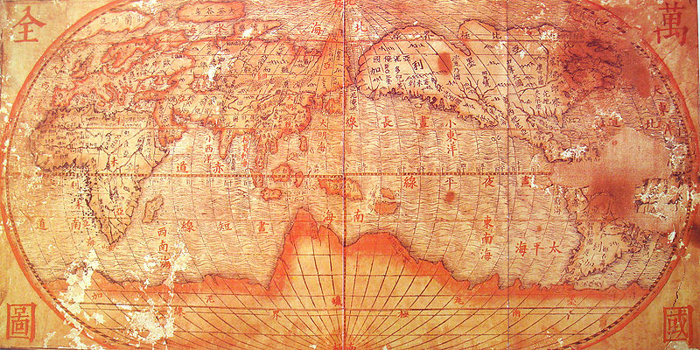
Intro: Confucian Tradition and New Cultural Influences
Emperors supported Neo-Confucianism, especially in education
Popular culture emerges with demographic growth and urbanization
Reintroduction of Christianity, plus European science and technology

Slide 20
Neo-Confucianism and Pulp Fiction
Neo-Confucianism (Zhu Xi): combined Confucian values with Buddhist philosophy
Emphasis on self-discipline, filial piety, obedience of rulers
Confucian education: supported by royal court (research institute, provincial schools, encyclopedias)
Popular culture: urban areas – uneducated, but literate -> new forms of entertainment (novels – reflected on world and human affairs)

Slide 21
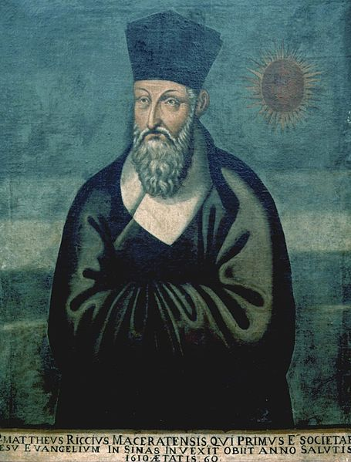
Return of Christianity to China
Earlier: Nestorians established churches and monasteries; communities disappeared with plague and fall of Yuan
Catholic missionaries (esp. Jesuits) returned in 16th century
E.g., Matteo Ricci: founded mission, wanted to convert emperor, impressed royal court with European science and technology
Calendars, maps, bronze casting, clocks

Slide 22
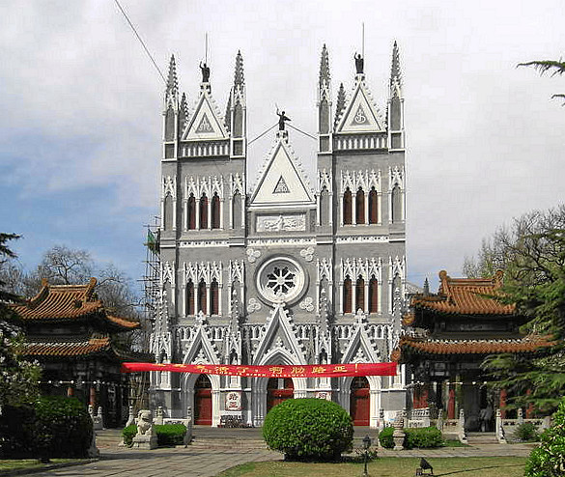
Confucianism and Christianity
Ricci also tried to link Christianity to Confucian doctrine, held religious services in Chinese, allowed converts to continue to venerate ancestors
Largely unsuccessful, as Christianity had to practiced exclusively
Mission ended when Franciscans and Dominicans complained about Ricci’s practiced to the pope
Impact: European science and tech.,
gave Europe a better understanding
of China (including bureaucracy and
Confucian morality)

Slide 23
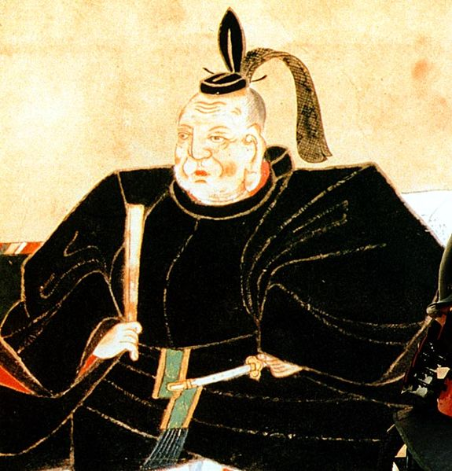
Intro: Unification of Japan
Tokugawa shoguns tried to build political and social stability
Restricted foreign influence
Demographic and economic growth -> social and cultural change (Chinese and European influence)

Slide 24
The Tokugawa Shogunate (review)
12th-16th centuries: shogun ruled through retainers (daimyo)who owned large estates
emperor = figurehead
14th -16th century competition between shogun and daimyo -> constant civil wars
End of 16th century: military leaders began to unify

Slide 25
Tokugawa Ieyasu
R. 1600-1616: established military government (descendants ruled until 1867)
Goal: stability and prevention of civil war -> had to control the daimyo (powerful landowners, own gov’ts, schools, money, contact with Europeans)
-> policy of alternate attendance: keep families and spend every other year in Edo (under shogun’s supervision), approval of marriage alliances, discouraged daimyo from visiting each other, required permission to work on castles

Slide 26
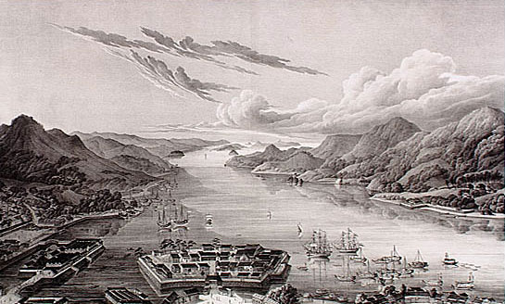
Tokugawa Ieyasu (cont.)
Also, wanted to prevent Europeans from destablizing society
1630s: edicts to restrict foreign relations
Japanese couldn’t go abroad or build boats, expelled Europeans, prohibited foreign merchants and books
Exception: Chinese and Dutch merchants at Nagasaki
Still couldn’t keep Japan completely isolated

Slide 27
Economic and Social Change
Agriculture increased (new crop strains, water control, irrigation, fertilizer) -> increased production (cotton, silk, indigo, sake) and population -> change
Population leveled off through pop. controls (contraception, late marriage, abortion, infanticide) to maintain higher standards of living
Social hierarchy similar to China’s
Change: ruling elites lost position, wealth, and military importance; merchants became wealthy, cities flourished

Slide 28
Neo-Confucianism and Floating Worlds
Embraced Neo-Confucianism (heavy Chinese influence): education
But, many scholars focused more on Japanese identities, saw Neo-Conf. and Buddhism as foreign and embraced folk traditions and Shinto
Emergence of popular culture as urban middle class flourished (cities = floating worlds, full of entertainment and pleasure)
Plus, pulp fiction, kabuki and puppet theater

Slide 29
Christianity and Dutch Learning
Christian missions: Jesuit Francis Xavier, 1549
Early: very successful
Then, backlash from government officials and moralists
Shogun restricted European access to avoid change, Buddhists and Confucians resented idea that only Christianity was right, converts resented not being able to be priests or leaders
1587-1639: shoguns’ decrees stopped Christianity in Japan
Tortured/killed missionaries who refused to leave and converts who refused to renounce

Slide 30
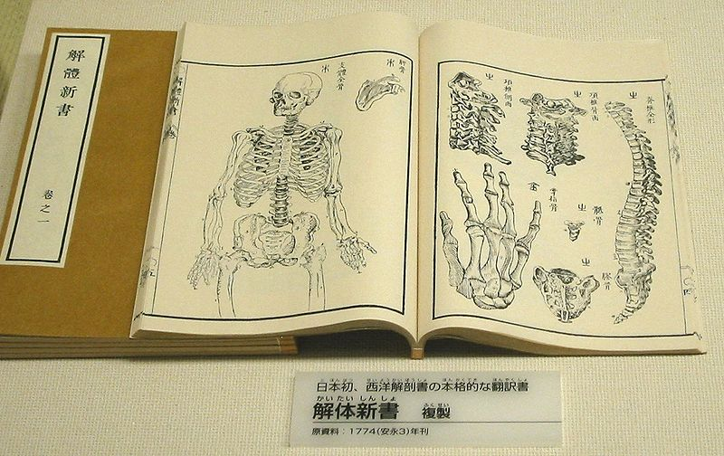
Dutch Learning
Post-1639: Dutch traders at Nagasaki became a source of information - “Dutch Learning”
Influence of European realistic art, linear perspective
Books translated into Japanese
European astronomy improved calendars
By mid-1700s: schools taught European medicine and Dutch studies

