Slide 1
The Unification of China
Chapter 8

Slide 2
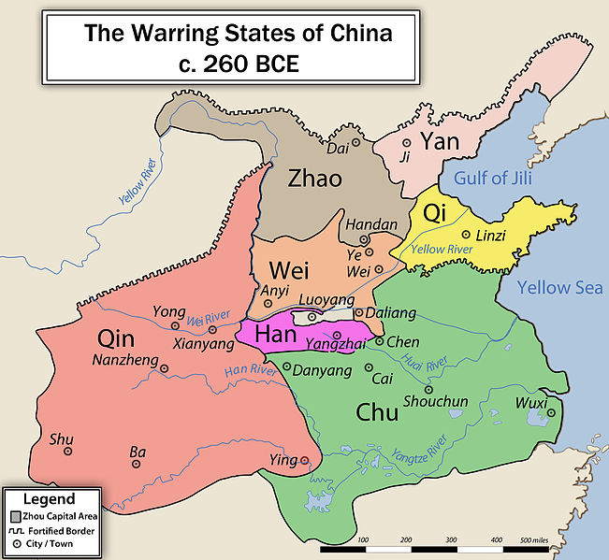
New Schools of Thought
Late Zhou = Warring States – lots of social and economic disorder
-> 3 philosophies

Slide 3
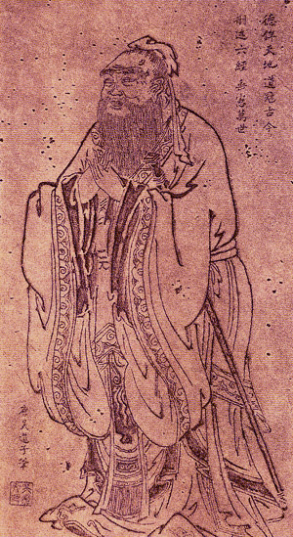
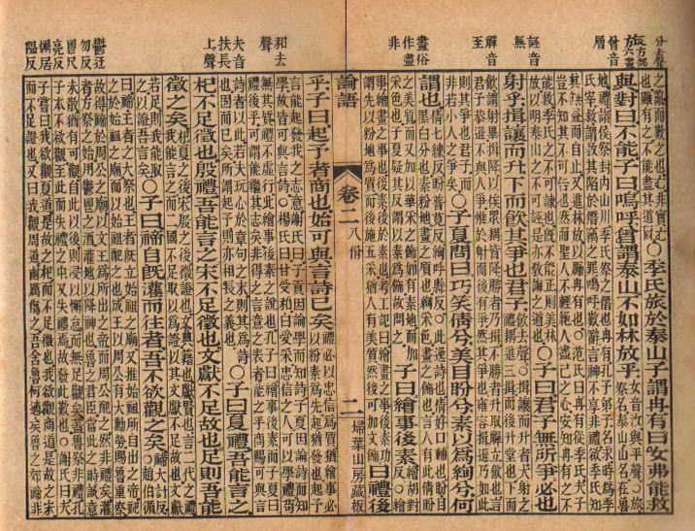
Confucianism
Confucius (551-479 BCE): educator and political advisor
Students wrote ideas/teachings (The Analects)
Taught from Zhou writings

Slide 4
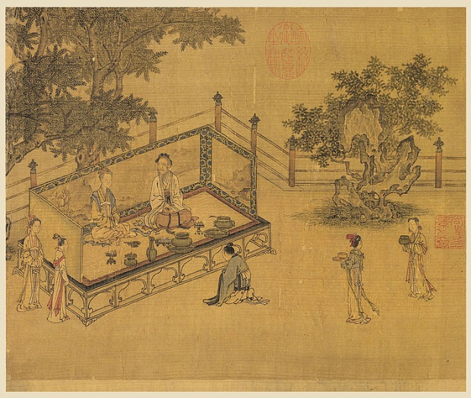
Confucianism (cont.)
Important qualities:
Ren = attitude of kindness (courteous, loyal, etc.)
Li = sense of propriety (behavior, respect of elders)
Xiao = filial piety (family: respect for parents)
Required enlightened leadership by morally strong
Has been adapted throughout Chinese history

Slide 5
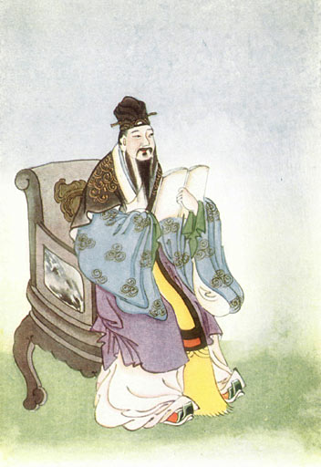
Confucianism (cont.)
Mencius: humans are good, govern with benevolence
Xunzi: humans pursue self-interest and need order through social discipline (standards of conduct)

Slide 6
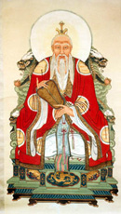
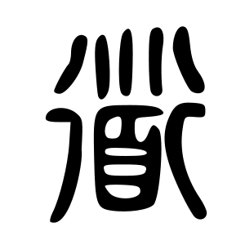
Daoism
Critics of Confucianism – instead of activism, reflection and introspection
Laozi (6th century BCE)
Live in harmony with the natural principles that govern the world (the Dao)
Followers wrote Daodejing

Slide 7
Daoism (cont.)
Forget the world of politics and administration – live simply
Moral virtue = wuwei (= disengagement from world affairs)
Advocates small, self-sufficient communities
Reality -> Confucianism in public, Daoism in private

Slide 8
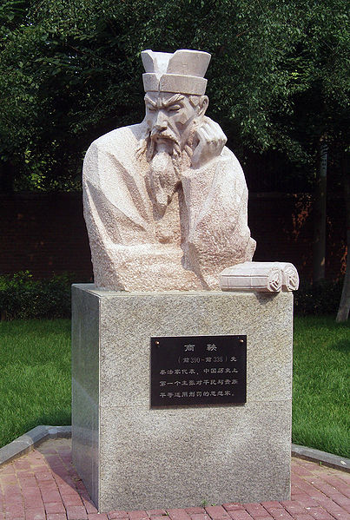
Legalism
Order and strengthening of the state
Shang Yang, et al. (300s BCE)
The Book of Lord Shang
Han Feizi, synthesized essays on statecraft

Slide 9
Legalism (cont.)
Foundations of state strength: military and agriculture
People are inherently bad and need government to teach them how to behave
Strict laws and punishments, deny self-interest, collective responsibility
Brought end to the Warring States

Slide 10
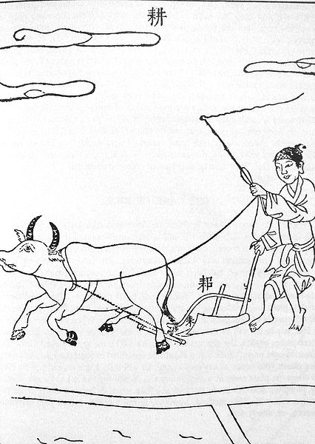
The Unification of China
Qin (one of the Warring States) had adopted legalism and began to dominate others
Focus on economic, political, and military development
Increased agricultural production (land rights to peasants, movement of farmers)
Centralized bureaucratic rule
(nobility less important)
built army with iron weapons and
expanded borders

Slide 11
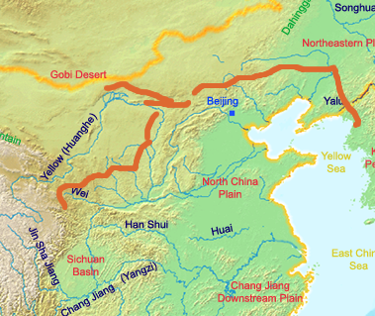
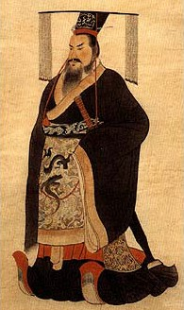
Qin Political History
221 BCE, king became emperor
Short (14 years), but with huge impact
Divided China into provinces governed by selected bureaucrats
Split old military forces (to stop rebellion)
Public works: roads, walls (Great Wall)
Critics: executed and destroyed their books
Standardized laws, currencies, weights
and measures, and script (writing)

Slide 12
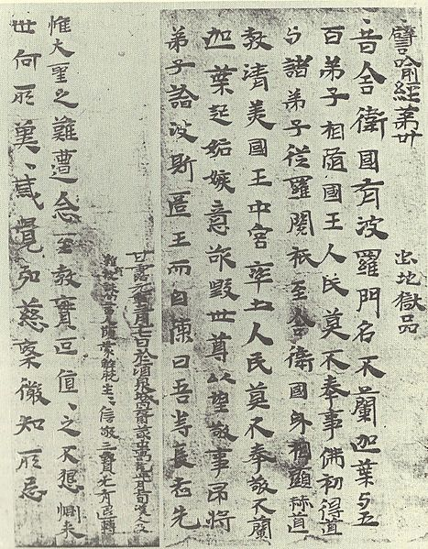
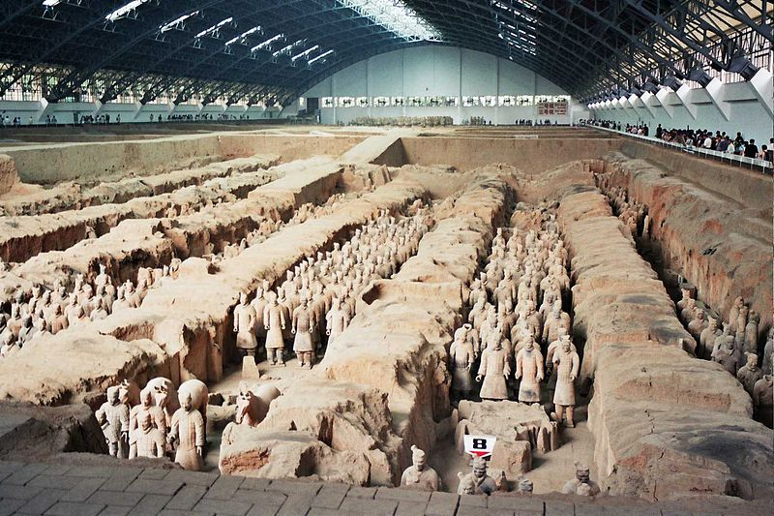
End of Qin
Public works laborers resented being moved to projects away from home
After first emperor’s death, lots of revolts
Dissolved in 207 BCE

Slide 13
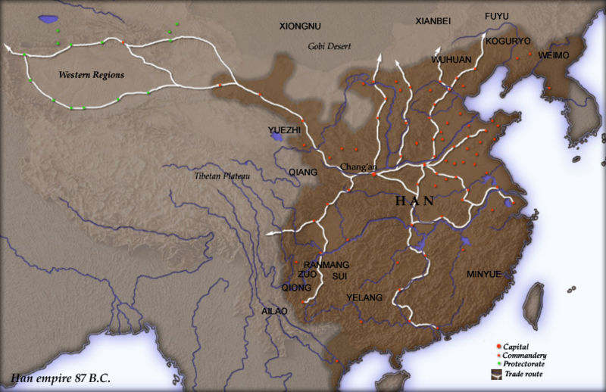
The Early Han Dynasty
return to centralized rule under military commander Liu Bang -> Han Dynasty (206 BCE – 220 CE)
At first, tried to be somewhat decentralized (land to family for support, with bureaucrat-governed districts)
-> problems -> became fully centralized (took land)

Slide 14
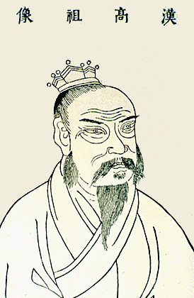
Han Wudi
The greatest Han emperor (r. 141-87 BCE)
2 main policies: centralized administration and imperial expansion
Statecraft:
Huge bureaucracy with imperial governors
Legalist principles
Roads and canals
Taxes (on agri., trade, crafts)
Imperial monopolies (on salt, iron)

Slide 15
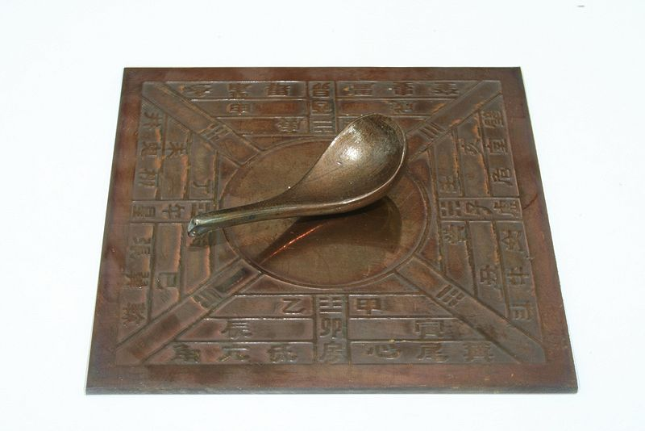
Confucian Education System
Problem: needed an educated group of bureaucrats
Established Confucian-style schools (including imperial university in 124 BCE)

Slide 16
Han Expansion
Invaded south (Vietnam) and east (Korea)
Greatest foreign challenge = the Xiongnu (horse-riding, Turkish steppe nomads)
Political organization: federation under Maodun (=empire)
At first, Han paid tribute and arranged marriages to avoid raids
Han Wudi decided to attack: took control, moved Chinese in, had control of most of E and C Asia = Pax Sinica

Slide 17
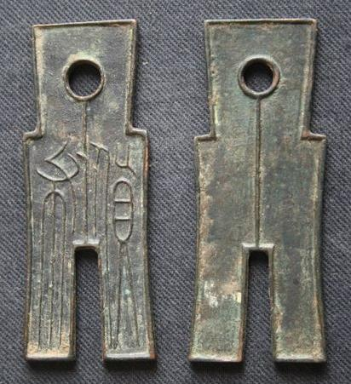
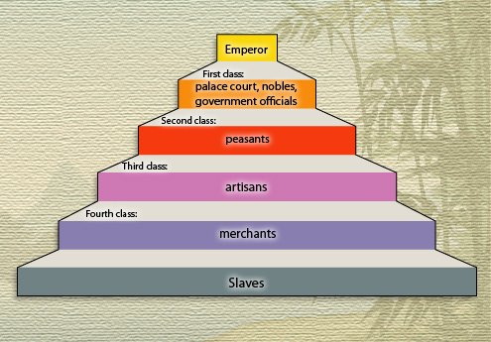
Han Prosperity
Socially, similar to Zhou: patriarchal, filial piety, honor and obey elders, expectations for women
Economically, most were farmers (iron tools increased surplus)
Iron: armor, weapons, cheaper than bronze
Silk: sericulture, mulberry leaves = fine silk, became important long-distance trade item
Paper

Slide 18
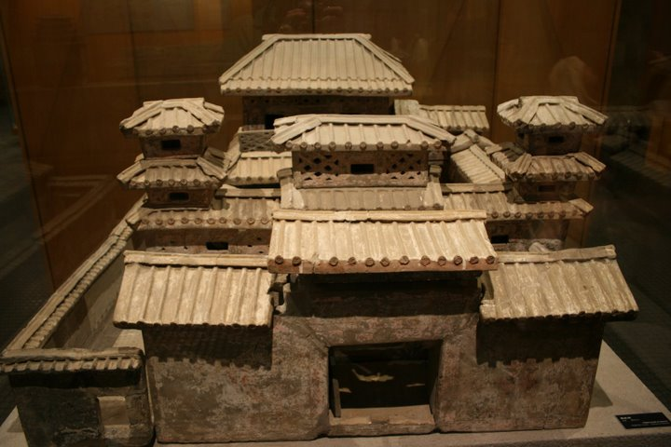
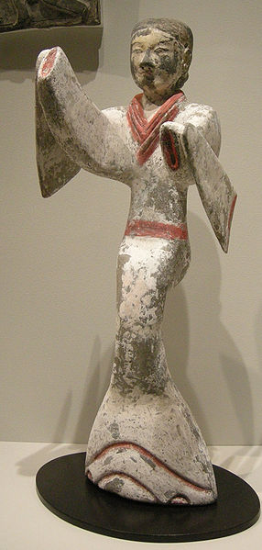
Economic and Social Difficulties
Social tension: increasing gap between rich and poor (conspicuous consumption) -> rebellion
Economic issues: debts forced farmers to sell land -> rich got more land and peasants became slaves or tenant farmers -> banditry and rebellion

Slide 19
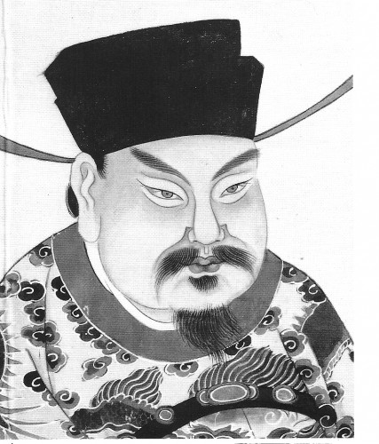
The Reign of Wang Mang
6 CE: Wang Mang became regent for 2 year old emperor
9 CE: with encouragement, claimed throne, citing Mandate of Heaven
Reforms:
limited land ownership per family
Split large estates and redistributed land

Slide 20
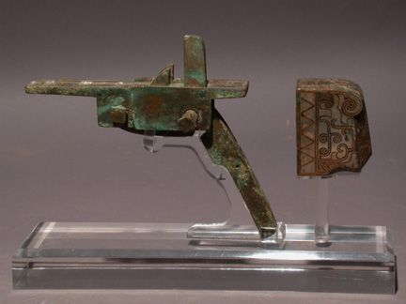
The Reign of Wang Mang (cont.)
Problems: changes made too quickly with little preparation -> confusion, not accepted
Plus, famine and poor harvests
-> revolts -> 23 CE, overthrown -> return of Han Dynasty

Slide 21
The Later Han Dynasty
Returned to throne, but weakened
Reorganized bureaucracy and centralized administration, fought Xiongnu, took control over silk roads
But, did nothing about land distribution (same problems) -> Yellow Turbans Uprising (Han kept control, but weakened further)
Court factions formed, leading to war
Collapse of Han due to internal weakness

